Slide 1
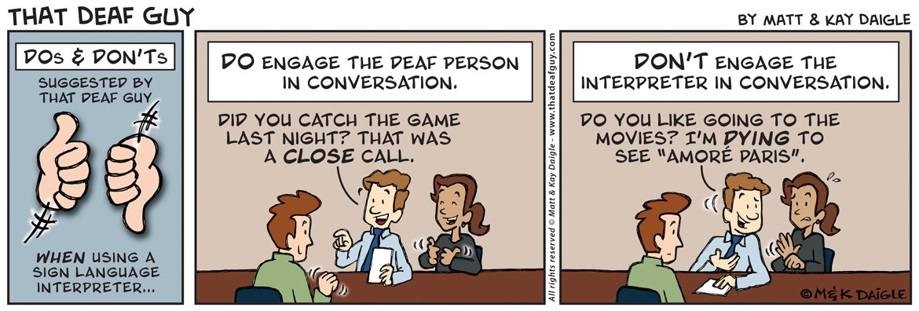
ASL
2ND Class

Slide 2
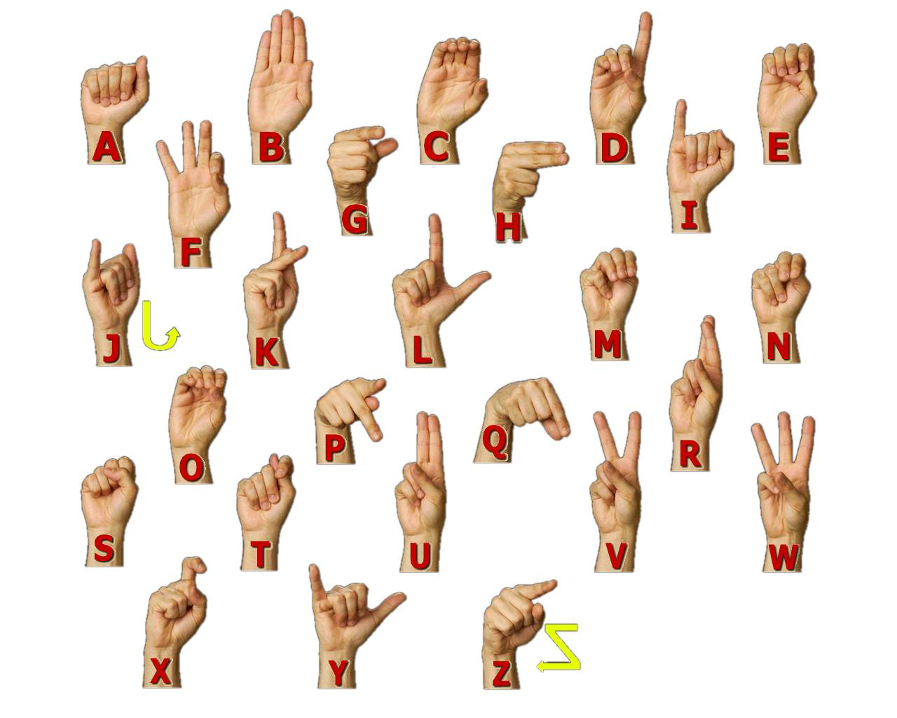
Review:
Questions?
Video
ABC’S
# 0-10
Spell your name

Slide 3
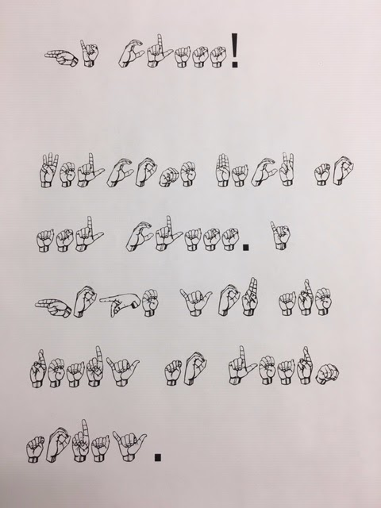

Slide 4
Review Vocabulary
Hello/Hi
Bye
What/Who/Where/When/How
What’s your name
My name is
Me-I
You
He/she/it
Nice to-meet you
See you Later

Slide 5
Group Activity
Asking for and Stating Name-
Sign:
1) Hello
2) Name you what? (What’s your name) OR Who you? (Who are you)
3) My name (My name is)
4) Nice meet you (Nice to meet you)

Slide 6
Survival Signs
Call Interpreter
Please/Sorry
Wait please
Again/Repeat
Do you have any question?
See you Later
All Done/Finished
Help
Yes/No
Dont Understand
Wrong/Right
Know/Dont know
Go ahead/Proceed
Fine/Good/Bad
Please go ahead
Sign Slow Please
Have a great day
Thank you
Welcome
Bathroom

Slide 7
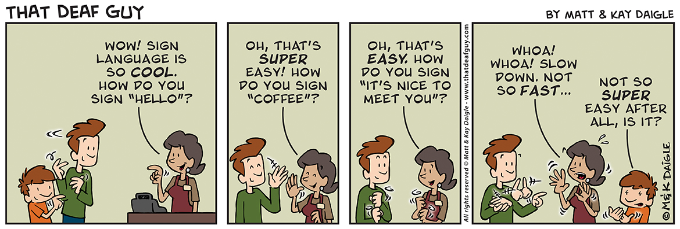
Questions?

